Slide 1
Human Activity Recognition
BY:
Reg No:
Guided by:

Slide 2
HUMAN ACTIVITY RECOGNITION
The goal of Human Activity Recognition (HAR) systems is to analyze patterns in video frames to infer the activities being performed by individuals.
HAR has been treated as a typical classification problem in computer vision and pattern recognition

Slide 3
HAR based on visual and sensory data has a huge number of potential applications
HAR has numerous applications across various domains including healthcare, fitness tracking, surveillance, and human-computer interaction.

Slide 4
AIM OF THE PROJECT
Develop a system capable of accurately recognizing and classifying human actions in video data.
This system uses machine learning and computer vision techniques to analyze pre-recorded video footage.

Slide 5

EXISTING SYSTEM
Title: Human Activity Recognition: Review, Taxonomy and Open Challenges
Author: Muhammad Haseeb Arshad
Published online: 2022 Aug 27
This is a article which studied 1200 papers about HAR.
In this article it shows which technologies are used to build the system in each paper

Slide 6
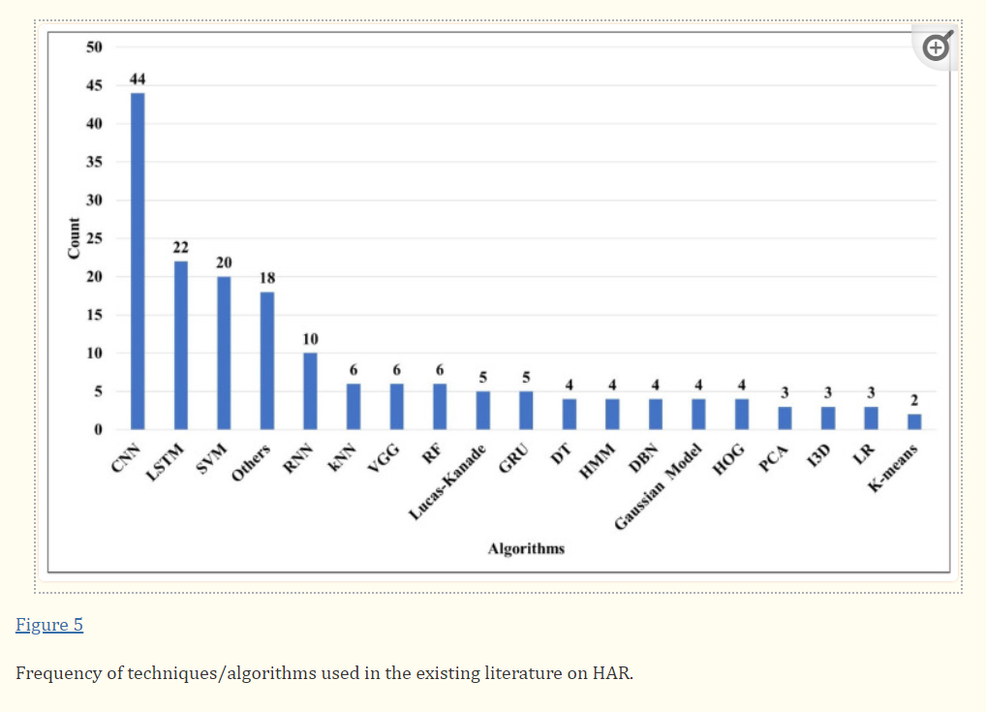



Slide 7
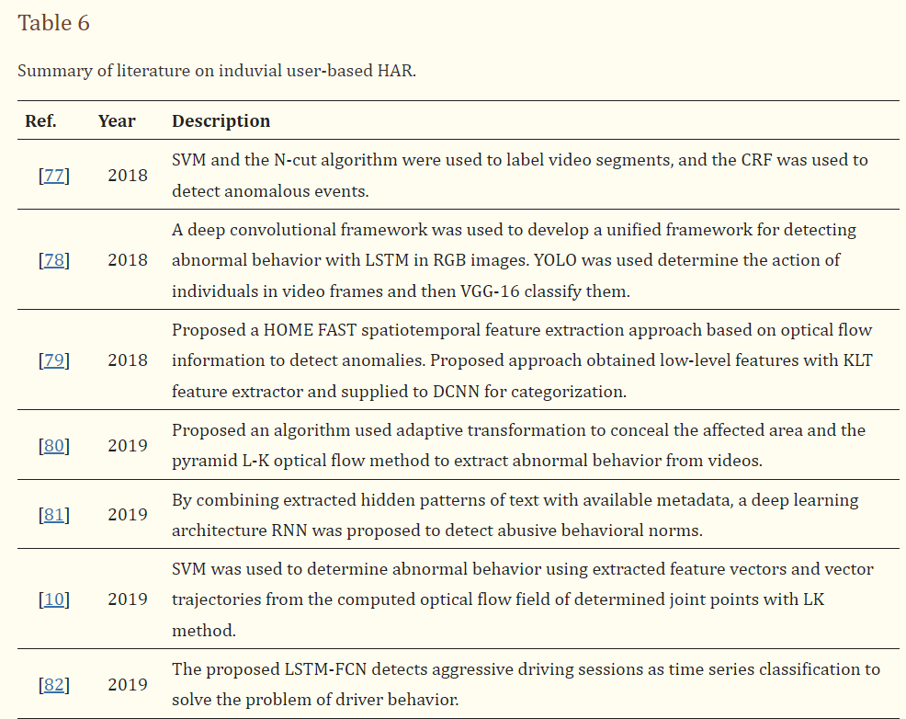
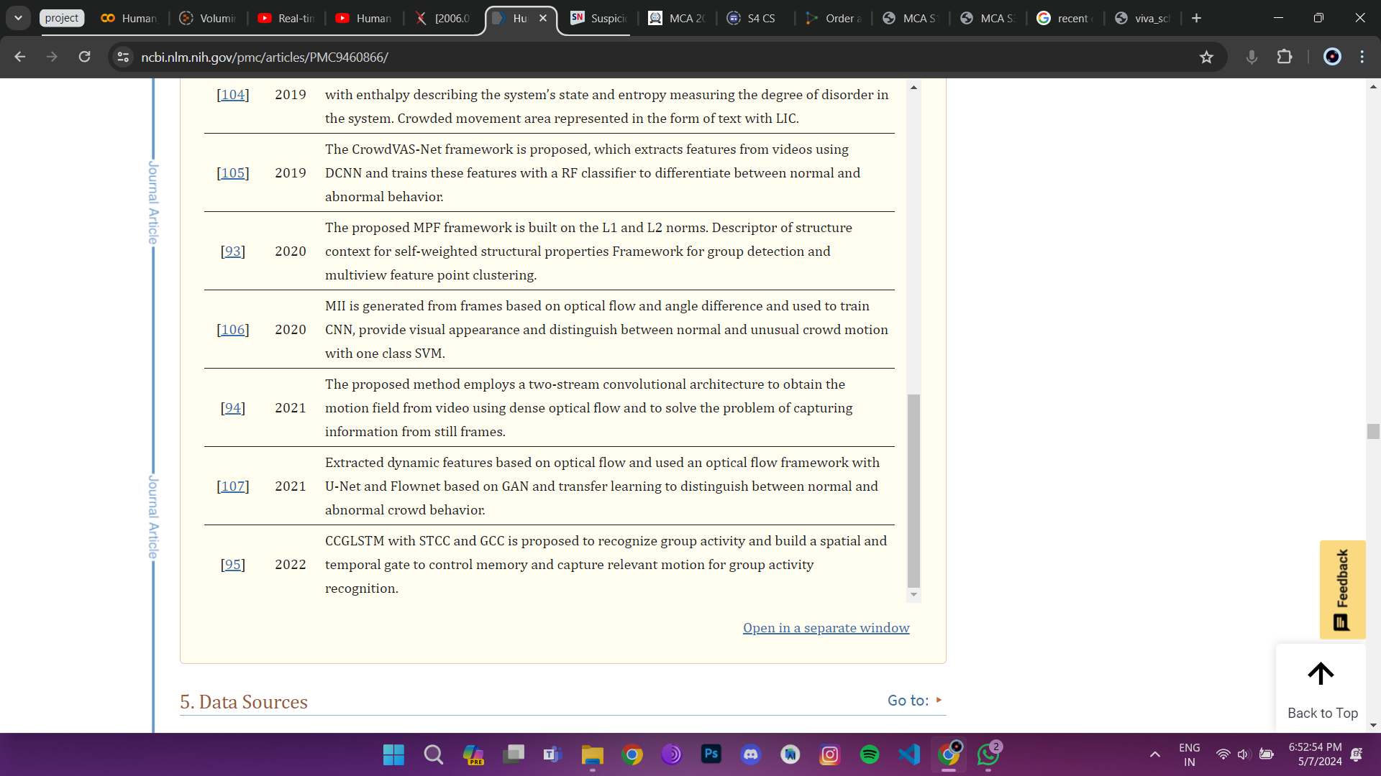

Slide 8
PROPOSED SYSTEM
By analyzing the article I decide to build a model which is a combination of most widely used models.

Slide 9
SYSTEM REQUIREMENTS
Hardware Requirements :
Processor: Intel Core i5
Hard disk: 80GB Minimum
RAM: 16 GB
Monitor: 13inch Monitor
Keyboard: Standard 101/102 keyboard

Slide 10
Software Requirements:
Operating System: Windows 11
Environment: Any Web browser
Front End: Streamlit
API: Python
Back End: Not used

Slide 11
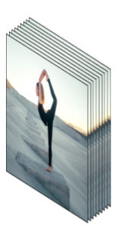
PROCESS FLOW
Input frames
Time distributed(Conv2D)
Input(20,64,64,3)
Output(20,64,64,16)
Time distributed(Maxpool2D)
Input(20,64,64,16)
Output(20,16,16,16)
Time distributed(Dropout)
Input(20,16,16,16)
Output(20,16,16,16)
Time distributed(Dropout)
Input(20,4,4,32)
Output(20,4,4,32)
Time distributed(Maxpool2D)
Input(20,16,16,32)
Output(20,4,4,32)
Time distributed(Conv2D)
Input(20,16,16,16)
Output(20,16,16,32)

Slide 12
Time distributed(Conv2D)
Input(20,4,4,32)
Output(20,4,4,64)
Time distributed(Maxpool2D)
Input(20,4,4,64)
Output(20,2,2,64)
Time distributed(Dropout)
Input(20,2,2,64)
Output(20,2,2,64)
Time distributed(Flatten)
Input (20,1,1,64) Output(20,64)
Time distributed(Maxpool2D)
Input (20,2,2,64) Output(20,1,1,64)
Time distributed(Conv2D)
Input(20,2,2,64)
Output(20,2,2,64)
LSTM
Input (20,64)
Output(32)
Dense
Input (32)
Output(11)
Yoga

Slide 13
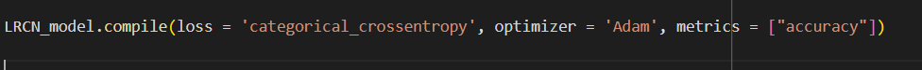
IMPLEMENTATION DETAILS
Data set:- UFC 101
Algorithms:- CNN, LSTM
Language :- Python
Framework :- Streamlit
Each Conv2D layer uses a RELU activation function

Slide 14
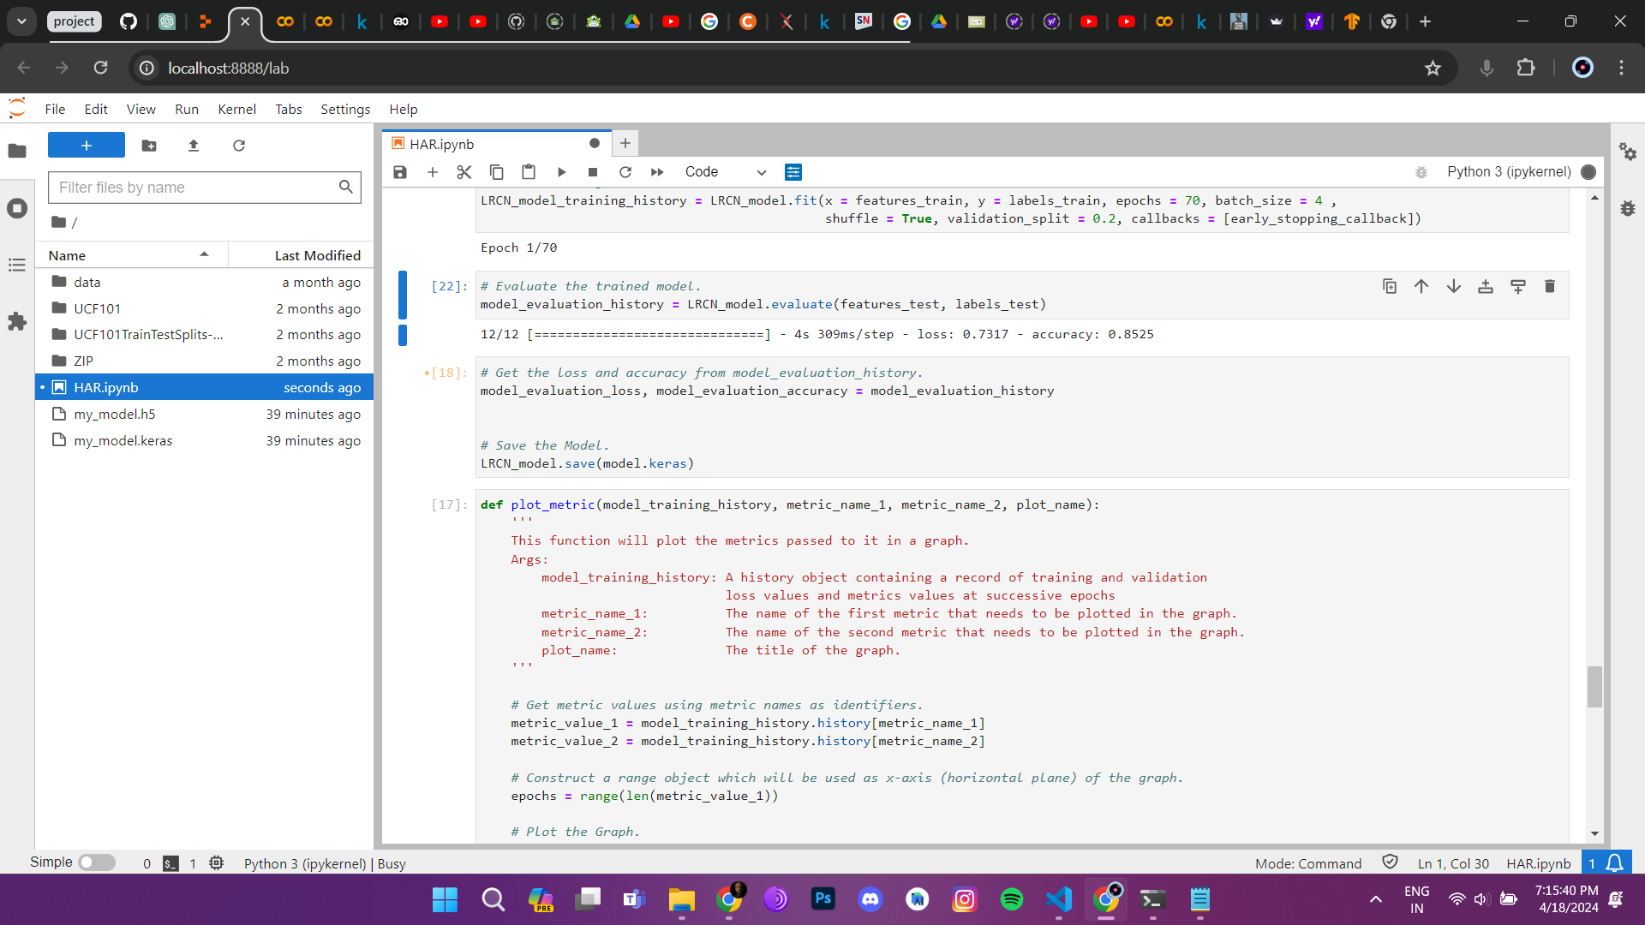
IMPLEMENTATION SCREENSHOTS
85% accuracy

Slide 15
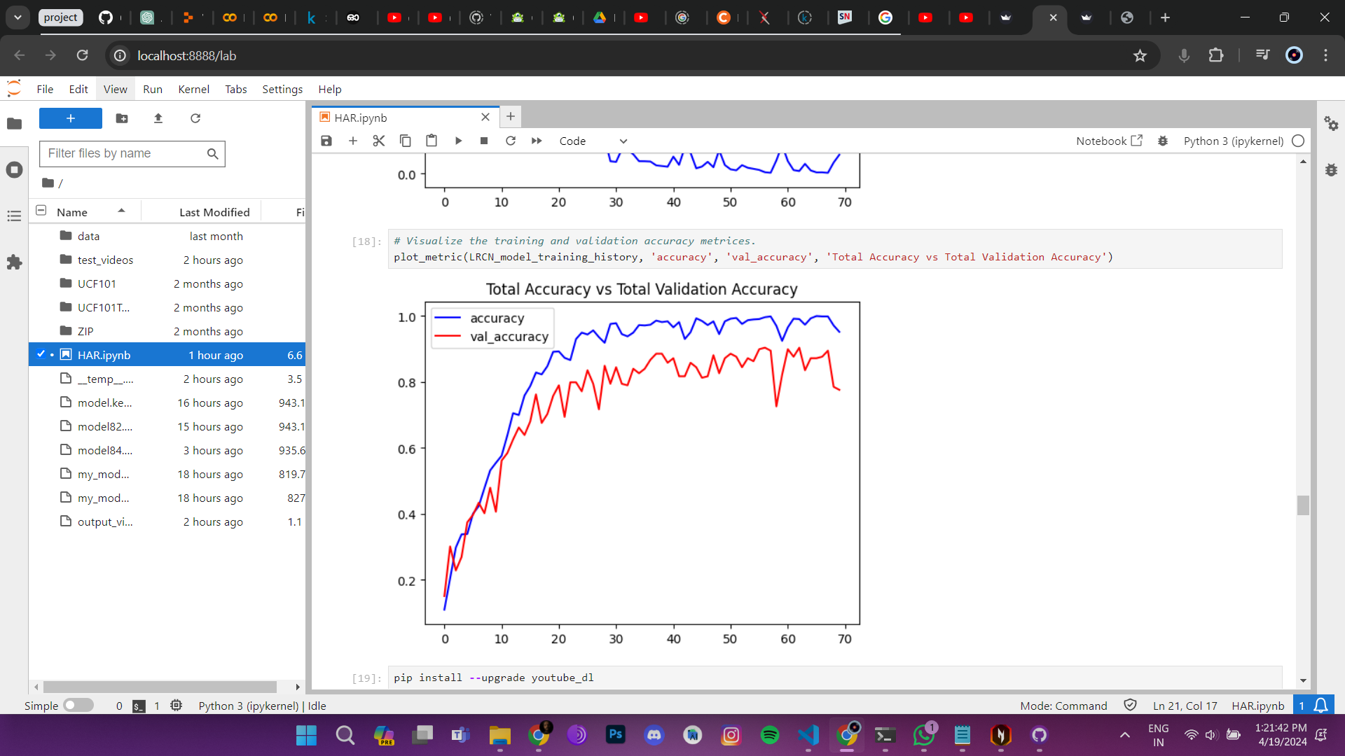
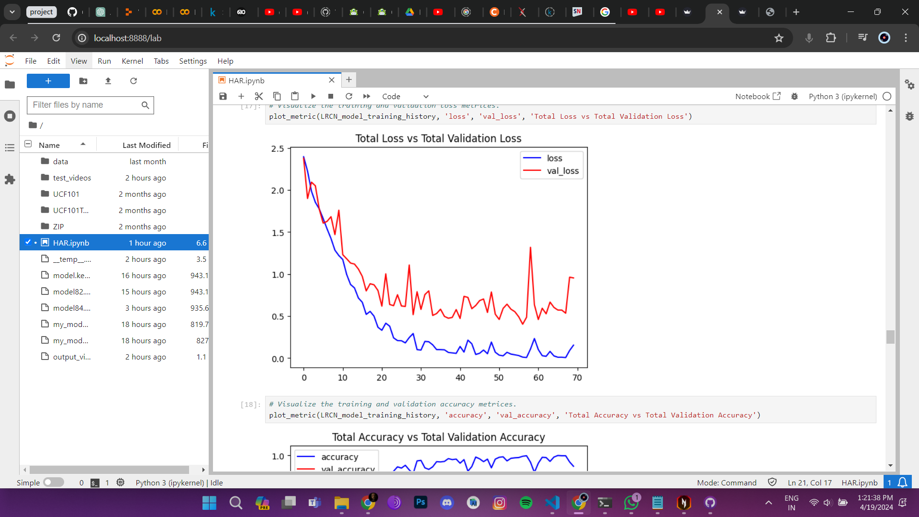
Accuracy Graph
Loss Graph

Slide 16
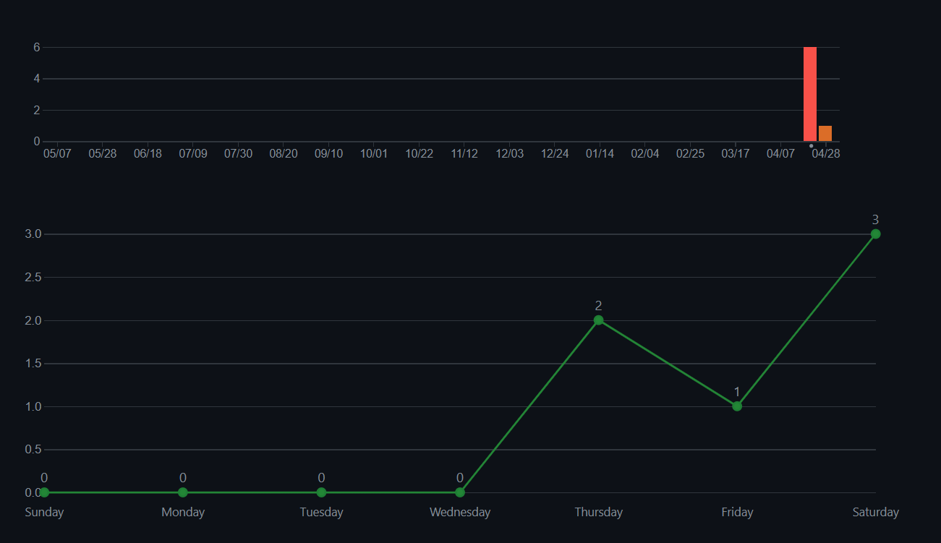
Git history graph

Slide 17


Slide 18
CONCLUSION
I success fully completed the project and the system works as expected
By the time of building the project I gained the knowledge about how modern technologies are working and got a chance to put hands on the futurestic technologies

Slide 19
In conclusion, the proposed system is like a combination of most widely used models. It's faster, more accurate, and can handle a wider range of tasks without needing constant human intervention.

Slide 20
REFERENCE
Gupta N, Human activity recognition in artificial intelligence framework: A narrative review. 2022
Dhiman C, A review of state-of-the-art techniques for abnormal human activity recognition. 2019
Beddiar D.R., Vision-based human activity recognition: A survey. 2020
ayak R., Review article A comprehensive review on deep learning-based methods for video anomaly detection. 2021
Wang Y., A survey on wearable sensor modality centred human activity recognition in health care. 2019

Slide 21
Hassan M.M., A robust human activity recognition system using smartphone sensors and deep learning. 2018
Zhu Q, A Novel Semisupervised Deep Learning Method for Human Activity Recognition. 2018
Khan Z.N., Attention induced multi-head convolutional neural network for human activity recognition. 2021
Rueda F.M., Convolutional neural networks for human activity recognition using body-worn sensors. 2018
HADIQA AMAN ULLAH, Analysis of Deep Neural Networks for Human Activity Recognition in Videos-A Systematic Literature Review. 2021

Slide 22
THANK YOU

